Slide 1
Drowsiness-monitoring-Using-OpenCV-Python - Venkateswara Rao Kotapati Professor – Dr Anwar Zahid

Slide 2
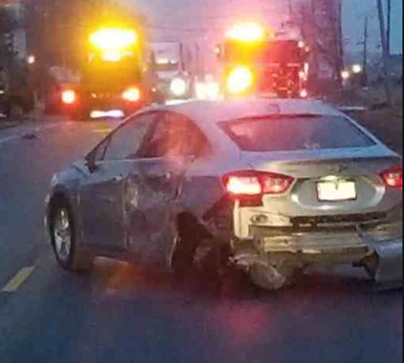
INTRODUCTION:
Aim of this project is implementing the system as a prototype by capturing the live images of the eyes and fed them into the Microcontroller in which the MATLAB software is used to process the video and convert it into frames and process it accordingly.
Some customized algorithms are coded in OpenCV and MATLAB for image segmentation of eyes from the entire image and image recognition of the eyes and face position.
Overall, by sensing the eye blinks we can decide if the eye blinks are more than the driver is very sleepy.

Slide 3
Future of Drowsiness Detection
Anti-drowsiness Alarm
Make Easy drive
Drive production
Medical accent
Directly interface to any Hardware using Arduino v
Low cost
High Security
This program can use for Aircraft Also

Slide 4
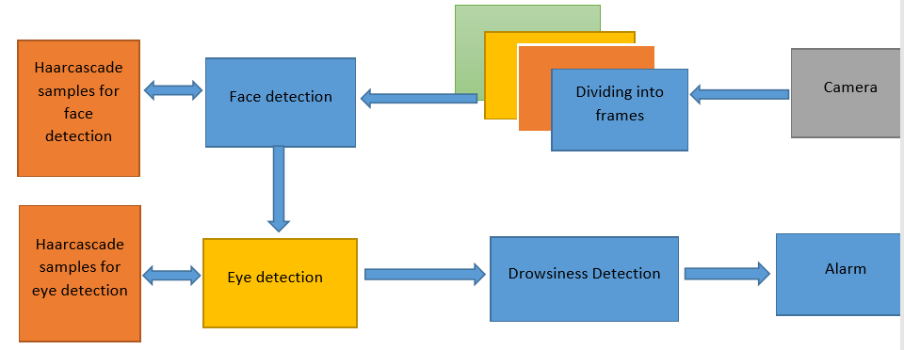
Drowsiness detection approach

Slide 5
Object/Face/Eye detection
Object detection is commonly defined as method for discovering and identifying the existence of objects of a certain class.
Also it can be considered as a method in image processing to find out an object from images. There are several ways to classify and find objects in a frame.
We know that face is also a type of object. So we can consider detection of face as a case of object detection.
In this type of object type of class detection, we try to know where the objects in the interest image are located and what is their size which may belongs to a class.
The work of algorithm that is made for face detection is mostly concentrated on finding the front side of the face.
Poor contrast of eyes generally creates a lots of problems in its detection. After successful detection of face eye needs to be detected for further processing.
In our method eye is the decision parameter for finding the state of driver. Though detection of eye does not look complex, but the actual process is quite hectic. In this case it performs the detection of eye in the specified region with the use of feature detection

Slide 6
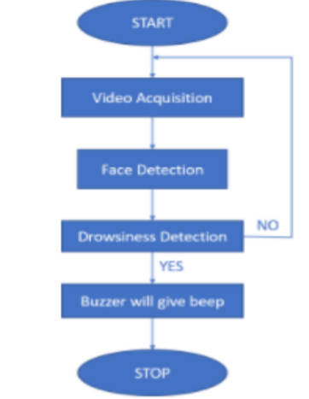
Working of system
This diagram shows how system will work on detection of face and eye

Slide 7
Cascade Classifier​
Haar Cascade is a machine learning object detection algorithm used to identify objects in an image or video and based on the concept of ​​ features proposed by Paul Viola and Michael Jones in their paper "Rapid Object Detection using a Boosted Cascade of Simple Features" in 2001
It is a machine learning based approach where a cascade function is trained from a lot of positive and negative images. It is then used to detect objects in other images.
A Haar Cascade is basically a classifier which is used to detect the object for which it has been trained for, from the source. The Haar Cascade is trained by superimposing the positive image over a set of negative images. The training is generally done on a server and on various stages.

Slide 8
LITERATURE REVIEW
As the goal of this literature review is to inform the choice of algorithms for comparison to algorithms, the following sections focus on presenting typical examples of the various approaches that have been attempted. For the purposes of this review, approaches are described in terms of a broad grouping of algorithms that seek to identify similar signatures of drowsiness. The approaches discussed in this review include driver-based, vehicle-based, and combination algorithms.
Face and Eye detection by Cellular Neural Network algorithms:
Face Detection using Haar Cascades:
Algorithm for Eye Detection on Grey Intensity Face

Slide 9
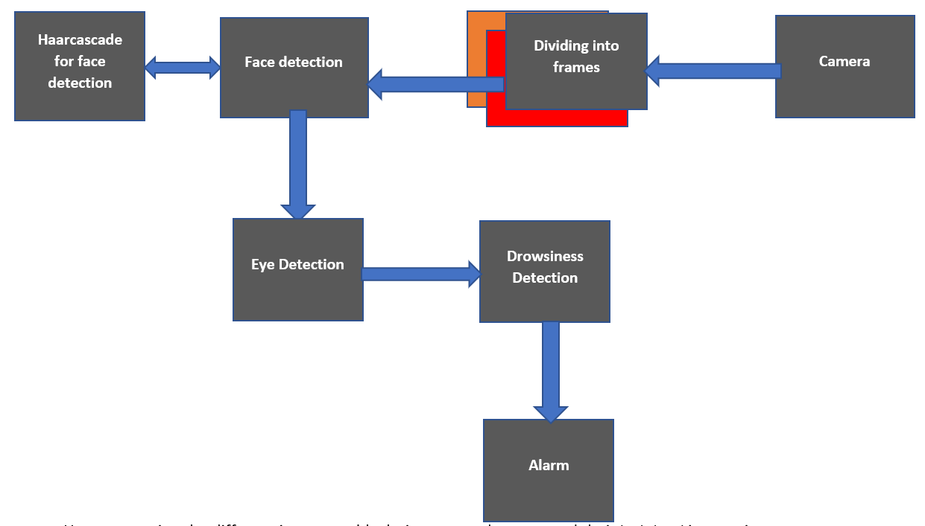
System Design/Architecture
Here presenting the different important blocks in proposed system and their high-level interaction. It can see that the system consists of 5 distinct modules namely, (a)Video acquisition, (b) Dividing into frames, (c)Face Detection, (d) Eye Detection and (e) Drowsiness Detection. In addition to these there are two external hardware’s like camera and audio alarm.
Video acquisition
Dividing into frames
Face detection
Eyes detection
Drowsiness detection

Slide 10
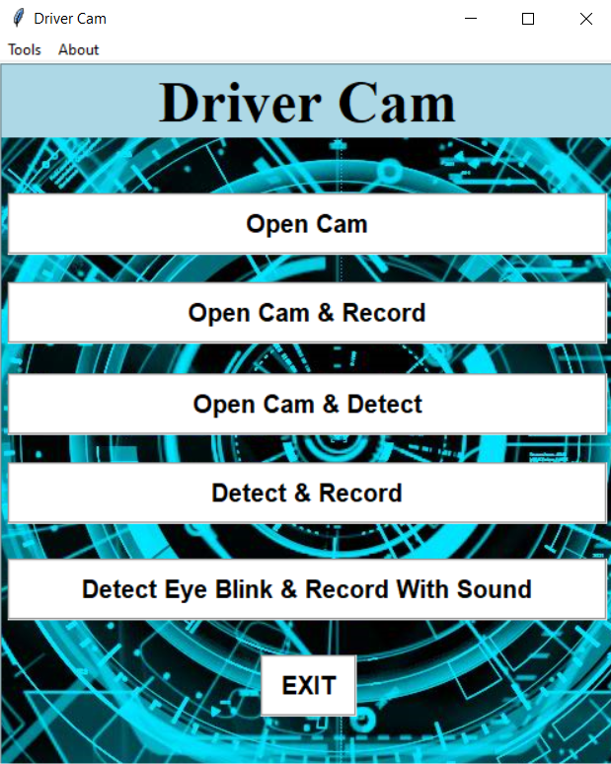
Real Time Application
Here we will know how that what was recorded and how function worked

Slide 11
Code
Everything written in Jupiter Notebook

Slide 12
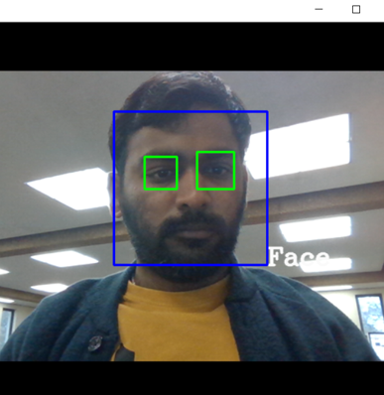
Testing with Male
Before implementing in car

Slide 13
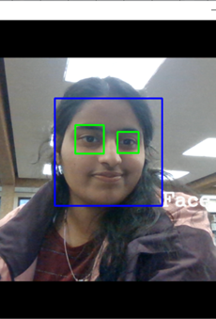
Testing with Female
Before implementing in car

Slide 14
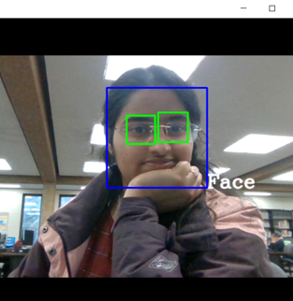
Testing with Female with Eyeglasses

Slide 15
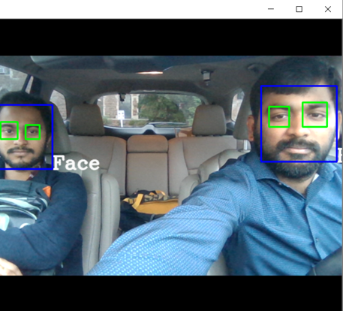
Real time testing in CAR
Implemented in Car

Slide 16
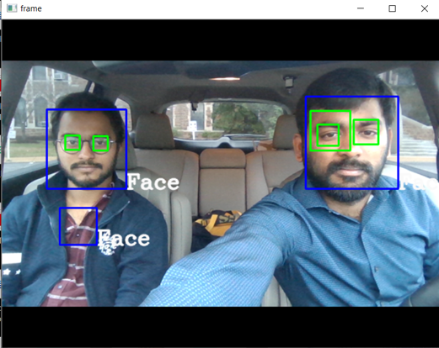
Real time testing in CAR with Eyeglasses
Implemented in Car

Slide 17
Thank you

